Slide 1
NEEDS ANALYSIS REPORT
STEPS TOWARDS ECOLOGICAL PLANET
ERASMUS+
2022-1-F101-KA220-SCH-000086671
Date: November 5th, 2022

Slide 2
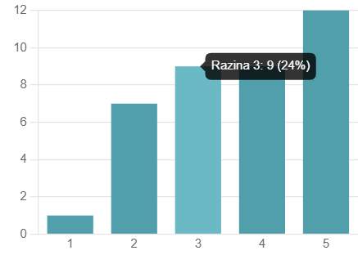
DO YOU INTEGRATE ENVIRONMENTAL ISSUES INTO THE CURRICULUM OF THE SUBJECT YOU TEACH? mean value 3,63

Slide 3
HOW COMPETENT ARE YOU WHEN YOU TEACH YOUR STUDENTS ENVIRONMENTAL SKILLS?
47 % of the teachers rated their competence as very good (4).
33% of the teachers rated their competence as good (3).
11% of the teachers rated their competence as excellent (5).
8% of the teachers rated their competence as sufficient (2).

Slide 4
What methods and activities do you use when teaching environmental skills?
Lessons, videos, diagrams, glossaries, project-based learning, guest speakers, analytical thinking, cooperative learning, examples from real life, using simulations, hollistic approach to learning, excursions, environment groups...
70% of the teachers use videos when teaching environmental skills

Slide 5
Do you need further knowledge regarding the methods and ativities used to teach the students environmental skills? Mean value: 3.37

Slide 6
Do you use digital tools for environmental education? If yes, how? If no, would you like to?
26 teachers answered positively and gave some examples of digital tools- approximately 70%.

Slide 7
Which key competences would your students need to develop in order to participate in the environmental education?
Basic knowledge about ecology and climate change, active citizenship, critical thinking, awareness of the current situation in the world, following the media, news and journals, evaluation of the statistical data related to ecology, teaching eco-friendly steps, problem identification, problem solving, inclusion in different projects, responsibility, citizenship

Slide 8
Do you have foreign language skills to implement environmental education in the subject you teach? 3,71 – mean value

Slide 9
DO YOU NEED TO PROMOTE INCLUSION OF STUDENTS WITH FEWER OPPORTUNITIES ( WITH SOCIAL, BEHAVIOURAL, EDUCATIONAL, GEOGRAPHICAL, CULTURAL, ECONOMICAL BARRIERS) IN YOUR INSTITUTION?

Slide 10
Would you like to learn together with your students about different cultures and lifestyles and to develop tolerance to differences?

Slide 11
How important is it for you that your institution becomes the forerunner in your community in the green thinking and practices? Mean value: 4.21

Slide 12
Thank you for your attention! DONE BY: xi. Gimnazija, zagreb, croatia, coordinator:M.schmidt

