Slide 1
FORESTS & JUNGLES
Forest experts

Slide 2
Forest & jungles
Forests/jungles provide us with many resources; medicine, building materials, air we breathe, etc.
Lungs of our planet
They soak up carbon dioxide and other gases

Slide 3
problems
Deforestation
Forest fires
Fragmentation
Air pollution

Slide 4
Aır pollutıon
Food
Industry
Transportation

Slide 5
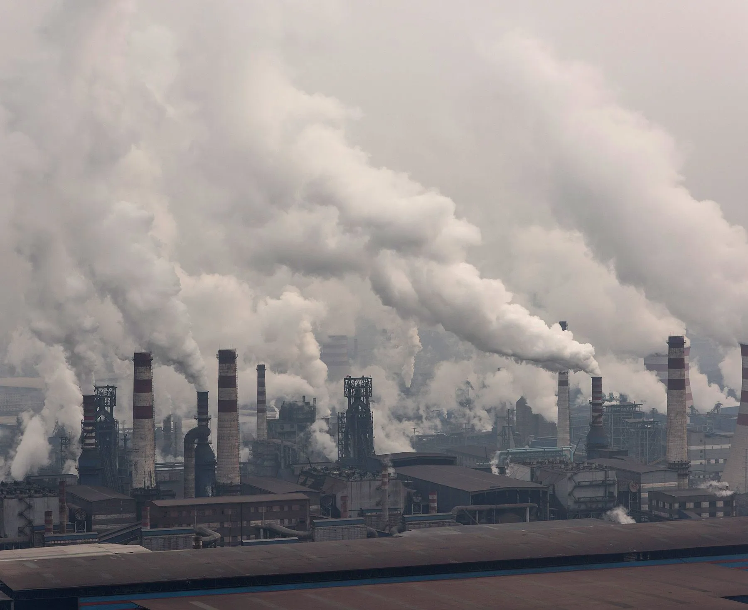
ındustry
EU has laws against industries that creates a lot of heavy water and CO2
Clean the industry and each country should be based on their natural resources
Closed sustainable economy for countries

Slide 6
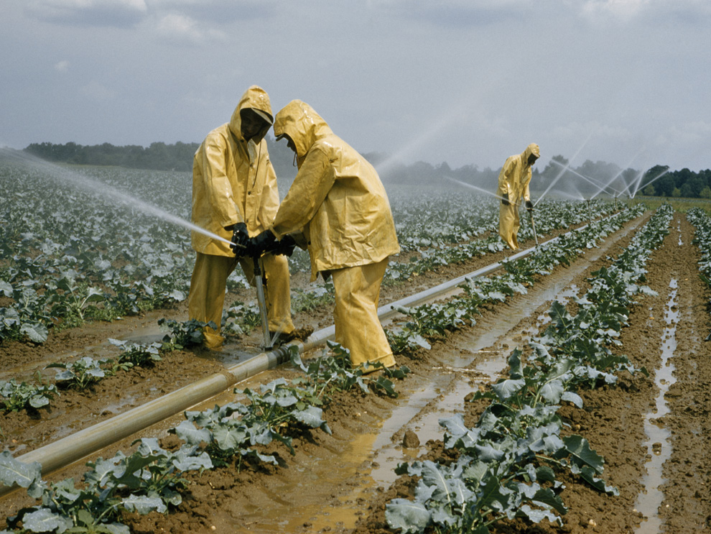
FOOd
Reduciıng pesticıdes
Three-fıeld system of agiculture
More of local meat (mass) production

Slide 7
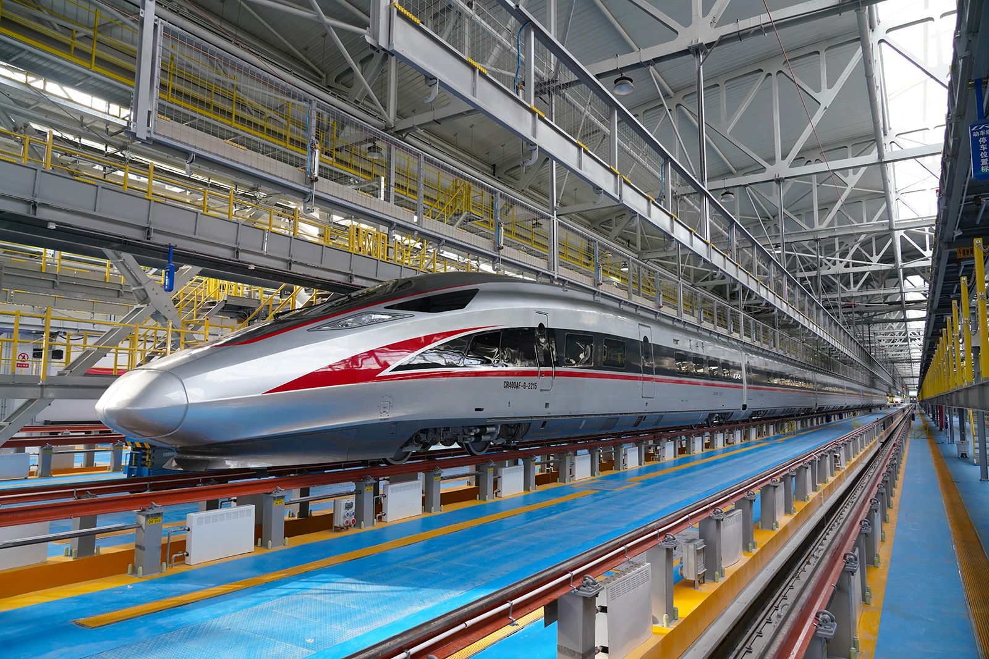
TRansportatıon
More railways
Nuclear power plant
Water engines

Slide 8
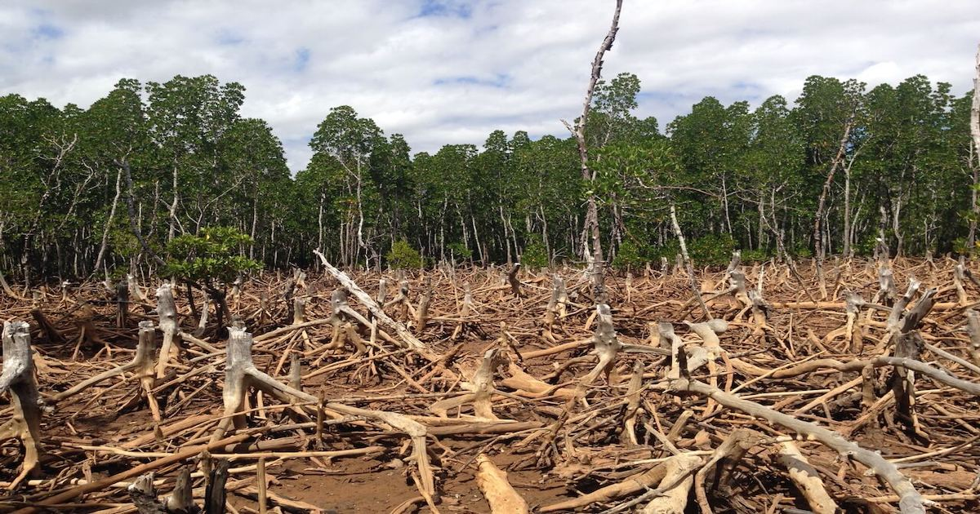
Deforestation
It is caused by logging or burning the woods down.
It causes to decrease in biodiversity.
Solution: Forests lands destroyed by fire or mining activites should be reforested and people should use all of the loged trees for production.

Slide 9
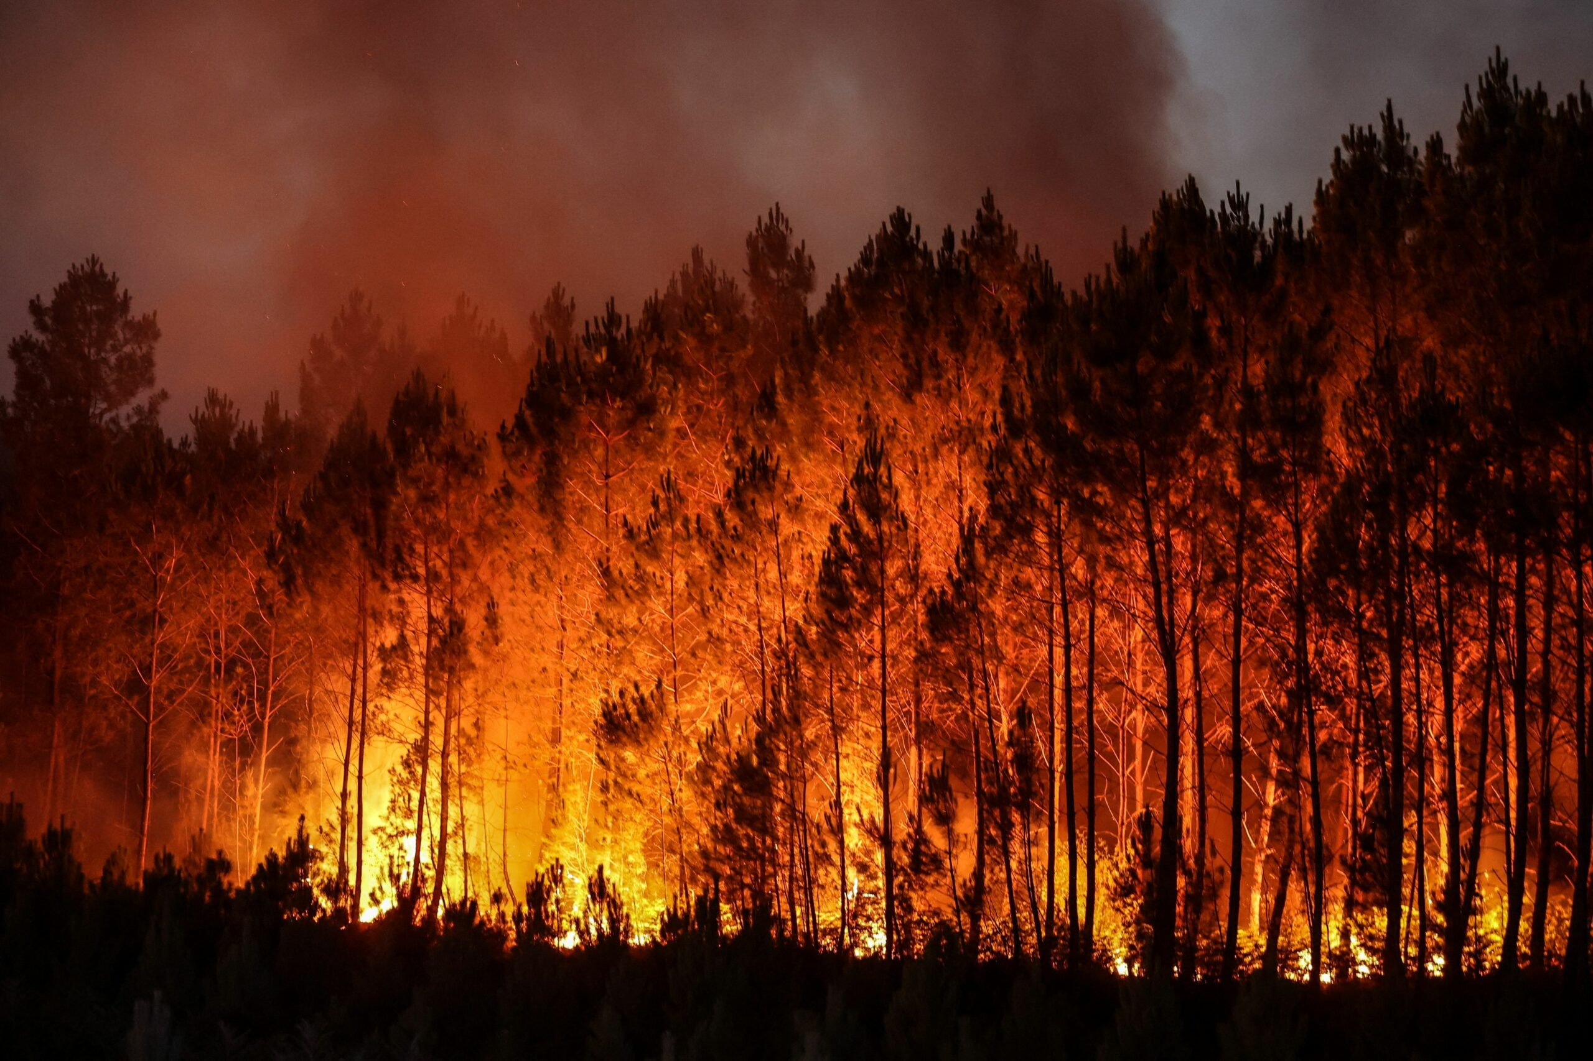
FOREST FIRES
Forest fires, both natural and human induced, pose a significant threat to forests and their ecosystems. Climate change has contributed to the increase in the frecuency and severity of wildfıres in some regions. Fires cam destroy habitats, release carbon into the atmosphere and threaten human communities near forests.
The goverment can do firewalls in the mountains so if there is any fire we can protect the most part of the trees and the mountains.

Slide 10
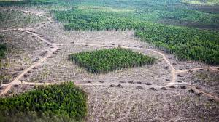
fragmentatıon
Forest fragmentation is a loss of forest and the division of the remaining forest into smaller blocks.
It is mostly caused by uncontrolled agriculture.
Solution: Preventing uncontrolled agriculture and food waste.

